Slide 1

Ensemble methods.
DATA ANALYTICS | IRONHACK

Slide 2

IRONHACK BOOTCAMP
ENSEMBLE METHODS MAIN IDEA
Combine multiple ML models in order to have a better prediction
We can combine models with two approaches:
Parallel ensemble
Sequential ensemble

Slide 3
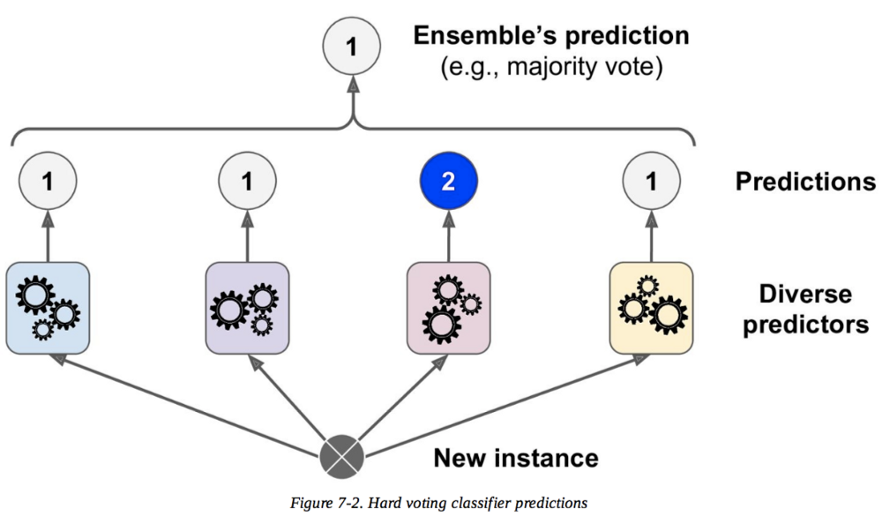
IRONHACK BOOTCAMP
PARALLEL ENSEMBLE METHODS
Improve multiple unstable ML models

Slide 4
IRONHACK BOOTCAMP
PARALLEL ENSEMBLE METHODS: RANDOM FOREST
Best example: Random Forests:
The RandomForest ML method uses lots of decision trees in order to provide a prediction.
Every decision tree in the forest is trained with a different random sample of:
Train set observations
Features
The final prediction is:
Average prediction of all the decision trees in the forest
Most frequent prediction of all the decision trees in the forest

Slide 5

IRONHACK BOOTCAMP
PARALLEL ENSEMBLE METHODS: RANDOM FOREST
sklearn random forest for regression
sklearn random forest for classification

Slide 6
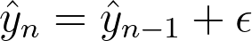
IRONHACK BOOTCAMP
SEQUENTIAL ENSEMBLE METHODS: BOOSTING
In this set of methods each prediction is an improvement over the previous prediction trying to predict the errors of the previous model.

Slide 7
SEQUENTIAL ENSEMBLE METHODS:
Adaptive boosting : training made upon misclassified observations. Increase the weight of sample observations in the training data set, where observations are hard to classify. Final prediction is based on majority vote, weighted by individual accuracy per tree.
Gradient boosting : trains to minimise loss using residual error, rather than update the weights of data points. Decision trees based on purity scores are added to the model, against the prior tree residual error. The final prediction is the sum of all tree predictions.

Slide 8
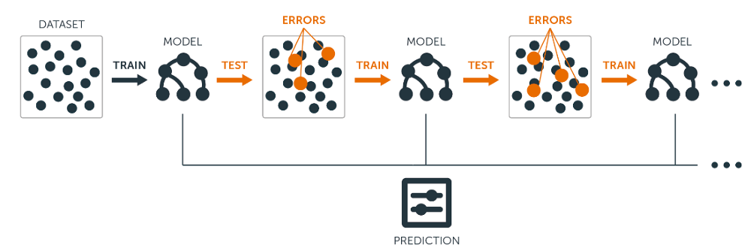
IRONHACK BOOTCAMP
SEQUENTIAL ENSEMBLE METHODS: BOOSTING
Adaboost:
sklearn adaboost regressor
sklearn adaboost classifier
Gradient boosting:
sklearn gradient boosting regressor
sklearn gradient boosting classifier

Slide 9
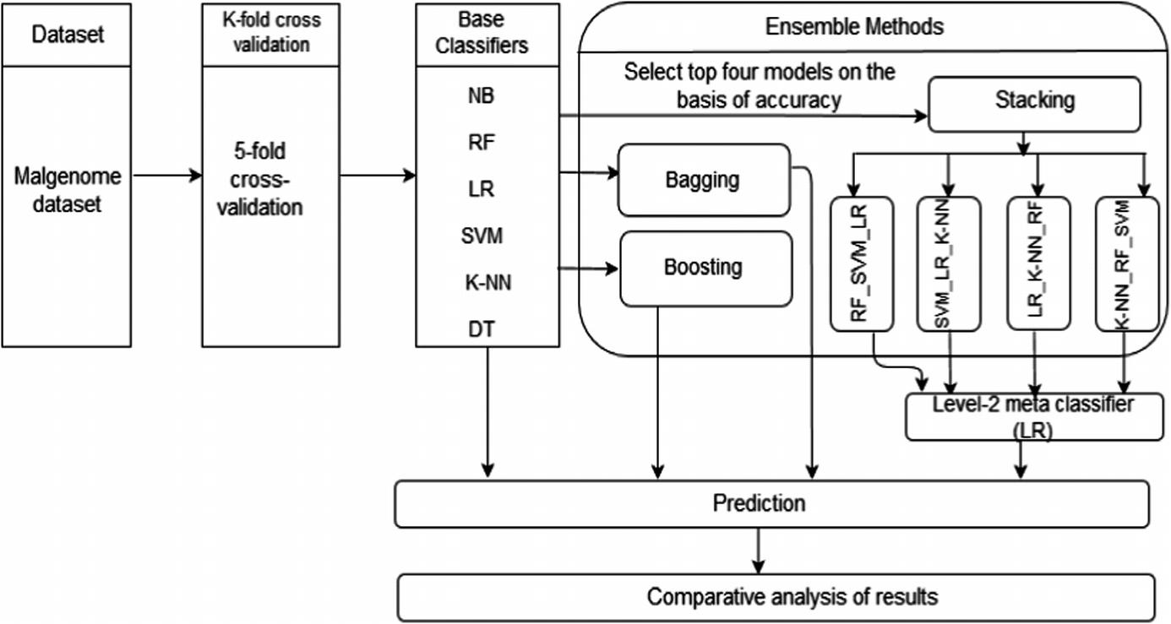
STACKING
Stacked generalisation:
Given multiple models that are skillful in different ways, and the observed errors are uncorrelated, how to choose which to trust?
The new super learner model learns how to best combine 2+ predictions of base machine learning algorithms
The base models chosen are typically different (unlike bagging)
A single simple meta model is then used to combine eg linear regression
Source machine learning mastery

Slide 10


